Slide 1




Meaningful Solutions for
Extraordinary Problem Behavior
Associated With Autism
Gregory P. Hanley. Ph.D., BCBA-D
2014 Transdisciplinary
Autism Conference

Slide 2
Autism is characterized by:
  Impairments in
  language development
  social interaction
  and
  Excessive repetitive behavior
Notes:
The latest estimate from the CDC is that about 1 in 50 children have been identified as having an Autism spectrum disorder is the US. There is no biological determination of autism; however, the behavioral symptoms are typically apparent before 3 years of age. Autism is characterized by impairments in social interaction and communication and by restricted, repetitive, or stereotyped patterns of behavior.

Slide 3
  With Autism, there is a higher likelihood of problem behavior
    Meltdowns
    Aggression
    Self-injury
    Chronic stereotypy
    Sleep problems
    References: Baghdadli, Pascal, Grisi, & Aussilloux, 2003; Horner et al., 2002; Kim et al., 2000; Murphy, Healy, & Leader, 2009; Thompson, 2009
Notes:
With Autism, there is a higher likelihood of problem behavior
Although a diagnosis of autism is not dependent on problem behaviors like meltdowns--those highly emotional outbursts and tantrums of extended duration that are clearly disproportionate to the circumstances--, aggression, or self-injury, the probability of one or more of these problem behaviors occurring with regularity is higher in children with autism than in children with other developmental disabilities.
For instance, researchers have reported a 10 to 15% prevalence rate of these problem behaviors in persons with an intellectual disability, By contrast, it was reported that 50% of a sample of 222 children with autism under the age of 7 engaged in self-injurious behavior; and that that 64% of a sample of 157 participants with autism aged 3 to 14 routinely engaged in at least one of the problem behaviors, with 32% of their sample showing all three behaviors.

Slide 4
  With Autism, there is a higher likelihood of problem behavior
  Self-injury
  10-15% prevalence in person with ID
  50% prevalence in persons with autism
Notes:
With Autism, there is a higher likelihood of problem behavior
Although a diagnosis of autism is not dependent on problem behaviors like meltdowns--those highly emotional outbursts and tantrums of extended duration that are clearly disproportionate to the circumstances--, aggression, or self-injury, the probability of one or more of these problem behaviors occurring with regularity is higher in children with autism than in children with other developmental disabilities.
For instance, researchers have reported a 10 to 15% prevalence rate of these problem behaviors in persons with an intellectual disability, By contrast, it was reported that 50% of a sample of 222 children with autism under the age of 7 engaged in self-injurious behavior; and that that 64% of a sample of 157 participants with autism aged 3 to 14 routinely engaged in at least one of the problem behaviors, with 32% of their sample showing all three behaviors.

Slide 5
  With Autism, there is a higher likelihood of problem behavior
  64% of children with autism routinely engage in at least one form of problem behavior
  32% of children with autism routinely engage in all three forms of problem behavior
    Meltdowns
    Aggression
    Self-injury
Notes:
With Autism, there is a higher likelihood of problem behavior
Although a diagnosis of autism is not dependent on problem behaviors like meltdowns--those highly emotional outbursts and tantrums of extended duration that are clearly disproportionate to the circumstances--, aggression, or self-injury, the probability of one or more of these problem behaviors occurring with regularity is higher in children with autism than in children with other developmental disabilities.
For instance, researchers have reported a 10 to 15% prevalence rate of these problem behaviors in persons with an intellectual disability, By contrast, it was reported that 50% of a sample of 222 children with autism under the age of 7 engaged in self-injurious behavior; and that that 64% of a sample of 157 participants with autism aged 3 to 14 routinely engaged in at least one of the problem behaviors, with 32% of their sample showing all three behaviors.

Slide 6

  But,
  Freedom
  from these behaviors
  for persons with Autism and their caregivers
  is attainable
Notes:
But, although these problem behaviors are highly prevalent among those diagnosed with autism, freedom for persons with Autism and their caregivers from these behaviors is attainable. Ironically, that freedom is possible with behavior analytic assessment and treatment.

Slide 7
    It is attainable
    without drugs
    without hospitalization
    without harsh punishment
    without candies, stickers, and token boards

Slide 8
    It is attainable
    by first understanding why the child is engaging in the problem behavior
Notes:
We have the technology to understand why.

Slide 9
    It is attainable
    when children are taught skills to help them navigate our complex social world
Notes:
We have the technology to understand why.

Slide 10
    It is attainable
    while showing complete respect for their preferences
    without altering their rich and unique personalities
Notes:
We have the technology to understand why.

Slide 11
    It is attainable
    with proper assessment and treatment by a BCBA
Notes:
We have the technology to understand why.

Slide 12
BCBAs
are Board Certified Behavior Analysts
with at least a Master’s degree
who are trained in the science behind and practice of applied behavior analysis (ABA)
Notes:
The criteria for saying something works are very rigorous in behavior analysis and still there is quite a bit of evidence behind behavior-analytic methods for addressing problem behavior.
This approach is practical and hopeful and, if you make it through to the end, you may even agree with me that it is the most dignifying of approaches to the unique problems associated with autism.

Slide 13
ABA or Applied Behavior Analysis is
the scientific study
and improvement
of behaviors of social importance
Notes:
The criteria for saying something works are very rigorous in behavior analysis and still there is quite a bit of evidence behind behavior-analytic methods for addressing problem behavior.
This approach is practical and hopeful and, if you make it through to the end, you may even agree with me that it is the most dignifying of approaches to the unique problems associated with autism.

Slide 14
Autism
Problem Behavior
Applied Behavior Analysis
An ABA approach is….
  Effective
  Practical
  Hopeful
  Dignifying
Notes:
The criteria for saying something works are very rigorous in behavior analysis and still there is quite a bit of evidence behind behavior-analytic methods for addressing problem behavior.
This approach is practical and hopeful and, if you make it through to the end, you may even agree with me that it is the most dignifying of approaches to the unique problems associated with autism.

Slide 15
Autism
Problem Behavior
*
Applied Behavior Analysis
*Main assumption
Severe problem behavior is understood as learned behavior influenced by its outcomes and context
Notes:
That freedom is possible with behavior analytic assessment and treatment. Because of its scientific assumptions and commitments, its proven methods, and its sensitivity to people’s values, including the child being served, .
In a nutshell, the most important assumption of behavior analysis, and arguably the field’s greatest contribution is that severe problem behavior is understood as learned behavior …. Learned like any other behavior and that it is influenced by its outcomes, past and present, and by its present context. No matter how extraordinary the problem behavior may look or last, behavior analysts seek to identify and understand the ordinary conditions and interactions that gave rise to continue to strengthen the behavior.
Please understand that emphasis on the learned nature of problem behavior in children with autism does not mean that I blindly overlook genetics or the unique neurobiology of children with ASDs. These are important factors to read about at this point, but I would like to teach you to look where the light is good—to the children’s environment and especially to what the child experiences each time they engage in any important behavior--for variables responsible for their behavior.

Slide 16
To determine the personally relevant outcomes and context that influence problem behavior
behavior analysts conduct
functional assessments
Notes:
That freedom is possible with behavior analytic assessment and treatment. Because of its scientific assumptions and commitments, its proven methods, and its sensitivity to people’s values, including the child being served, .
In a nutshell, the most important assumption of behavior analysis, and arguably the field’s greatest contribution is that severe problem behavior is understood as learned behavior …. Learned like any other behavior and that it is influenced by its outcomes, past and present, and by its present context. No matter how extraordinary the problem behavior may look or last, behavior analysts seek to identify and understand the ordinary conditions and interactions that gave rise to continue to strengthen the behavior.
Please understand that emphasis on the learned nature of problem behavior in children with autism does not mean that I blindly overlook genetics or the unique neurobiology of children with ASDs. These are important factors to read about at this point, but I would like to teach you to look where the light is good—to the children’s environment and especially to what the child experiences each time they engage in any important behavior--for variables responsible for their behavior.

Slide 17
What is a functional assessment?
(You can’t hold it in your hand)
  It is a process
    through which the variables influencing problem behavior are identified
Notes:
Process for determining the contingencies influencing problem behavior

Slide 18
Why conduct a functional assessment?
In order to identify
an effective
precise
personally relevant,
and
humane treatment
for problem behavior
Notes:
You might not agree with me, so let’s do some perspective taking:
You experience some temporary muscle paralysis which does not allow you to talk or write or engage in controlled motor movements. You are now on many meds that dry out your eyes, your nose, your skin, and your mouth. Water is viewable, but unattainable. You learn that if you bang the bed rails long enough and loud enough people will give you things, one of which is the water. So the banging continues to such an extent that you are bruised and your caregivers annoyed. The consulting behavior modifier shows up and with a program of contingent restraint “to ensure your safety” and access to a radio and some skittles when you are not banging. ….Your problem behavior occurs much less frequently. It doesn’t go away, but your bruises are healing and the staff is certainly less annoyed with you. Job well done? I don’t think so.
If there were a tool available to allow your caregivers to know the simple reason why you were hurting yourself and annoying them, wouldn’t you want it employed. Wouldn’t it be great to just be able to push a button and get the water. The functional assessment process makes this humane and practical outcome possible. So let’s return to the earlier question and provide a better answer: Why conduct a functional assessment of problem behavior?
We do it, you should do it….**In order to identify an effective, precise, personally relevant, and humane treatment for problem behavior.
Why don’t most behavior analysts do it—many reasons for sure, but most likely because of the pervasive myths about the process.

Slide 19
Functional Assessment Process
Indirect Assessment an open ended interview with primary caregivers
Descriptive Assessment
brief observation
and casual interaction
Functional Analysis
Systematic observation within two different and carefully designed contexts
Test
Control
Notes:
A functional assessment is a process; a process in which the variables influencing problem behavior are identified prior to treatment and are used to inform the treatment development.
The process usually involves some sort of combination of indirect assessment, descriptive assessment, and functional analysis. Descriptive assessment involves observation and measurement of the problem behavior and its context; by contrast, functional analysis consists of observation and measurement of the problem behavior in at least two contexts, each distinctly designed from the interview so that the variables suspected of influencing problem behavior are conspicuously present in one (referred to as the test condition) and absent in the other (referred to as the control condition).
*Functional analyses of problem behavior are prominent in the behavioral assessment literature having appeared in over 400 studies through last year with almost a 1000 distinct analyses published.
In his review large review of treatments for problem behaviors associated with autism, Campbell found that larger reductions in problem behavior were clearly evident when a functional analysis was part of the functional assessment process.

Slide 20
  These are not experimental techniques awaiting validation
  435 studies with functional analyses and
  981 distinct functional analyses
  have been published between 1961 and 2012
    Beavers, Iwata, & Lerman, 2013; Hanley, Iwata, & McCord, 2001
Notes:
These are not experimental techniques
*Functional analyses of problem behavior are prominent in the behavioral assessment literature having appeared in over 400 studies through last year with almost a 1000 distinct analyses published.
In his review large review of treatments for problem behaviors associated with autism, Campbell found that larger reductions in problem behavior were clearly evident when a functional analysis was part of the functional assessment process.

Slide 21
  The functional analysis is integral to the success of the process
  Larger reductions in problem behavior were evident
  when a functional analysis was part of
  the functional assessment process
    Campbell, 2002; Kahng, Iwata, and Lewin, 2003
Notes:
These are not experimental techniques
*Functional analyses of problem behavior are prominent in the behavioral assessment literature having appeared in over 400 studies through last year with almost a 1000 distinct analyses published.
In his review large review of treatments for problem behaviors associated with autism, Campbell found that larger reductions in problem behavior were clearly evident when a functional analysis was part of the functional assessment process.

Slide 22
  But,
  most people,
  including most practicing behavior analysts who work with children with autism
  have shied away from conducting
  functional analyses
Notes:
These are not experimental techniques
*Functional analyses of problem behavior are prominent in the behavioral assessment literature having appeared in over 400 studies through last year with almost a 1000 distinct analyses published.
In his review large review of treatments for problem behaviors associated with autism, Campbell found that larger reductions in problem behavior were clearly evident when a functional analysis was part of the functional assessment process.

Slide 23

  It has taken a lot of research, but there are no longer obstacles to conducting functional assessments including functional analyses
Free pdf:
http://www.ncbi.nlm.nih.gov/pmc/articles/PMC3546636/pdf
Notes:
These are not experimental techniques
*Functional analyses of problem behavior are prominent in the behavioral assessment literature having appeared in over 400 studies through last year with almost a 1000 distinct analyses published.
In his review large review of treatments for problem behaviors associated with autism, Campbell found that larger reductions in problem behavior were clearly evident when a functional analysis was part of the functional assessment process.

Slide 24
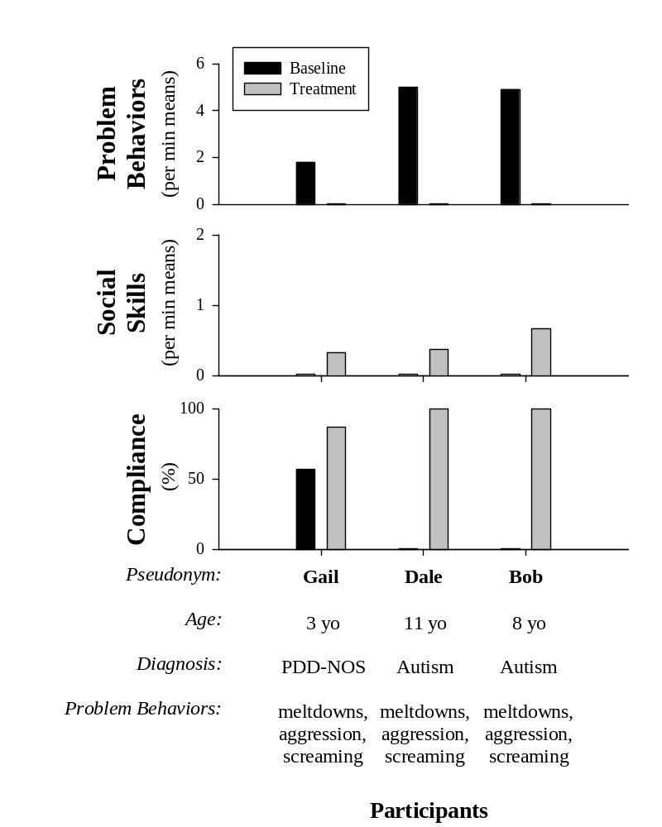
Producing Meaningful Improvements in Problem Behavior of Children with Autism via Synthesized Analyses and Treatments
Hanley, Jin, Vanselow, & Hanratty (in press) JABA
Participants
Notes:
It is, however, hard to find examples of the entire assessment and treatment process in our literature. From the initial meeting to the point when parents say thank you, problem solved. Part of the reason is because there are real challenges to extending behavioral intervention from the clinic to the home or school…. But a larger part of it is a function of our highly fractured, very micro-analytic literature that describes but bits of the process across separate studies.
I have contributed to the highly fractured literature of which I am complaining about, but more recently, I have been working on addressing this research to practice to gap, and I am going to show a few examples that illustrate the entire functional assessment and treatment process in an outpatient model that I run with doctoral candidates at Western New England University.

Slide 25
Case Example: Gail, 3 years old, PDD-NOS
Interview suggested that Gail engaged in meltdowns and aggression….
when Mom was attending to other tasks or people….
in order to gain Mom’s undivided attention and to have Mom play with her and her most preferred toys.
Notes:
I will describe the assessment for Gail, the 3 year old girl first. Gail had long beautiful dark hair, her mother always dressed her impeccably, and Gail was quite excellent with dramatic play. The main issue was that she had 5 to 10 meltdowns per day that lasted from a few minutes to about an hour and it was difficult for her mother to ever predict which one was coming. She also was very aggressive towards siblings and parents, and highly noncompliant with adult instructions.
The interview suggested that Gail engaged in meltdowns and aggression in order to obtain preferred items (usually toys) and maternal attention. This is where I like to point out that extraordinary behavior is usually influenced by very ordinary events and interactions.
Our analysis then involves two conditions—the test, in which we try to emulate the conditions under which the problem has been reported to occur and the control, in which the factors thought to be responsible for problem behavior are removed. We alternate between 5 min test and control sessions in small observations rooms in our outpatient clinic at the university.

Slide 26
Functional Analysis
Systematic observation within two different and carefully designed contexts
  a period of time in which the variables thought to be responsible for problem behavior are arranged
  -the outcomes that matter are called reinforcers
    -the presumed reinforcers are withheld until problem behavior occurs and then they are delivered for a short period of time
  This is called the Test condition
Notes:
A functional assessment is a process; a process in which the variables influencing problem behavior are identified prior to treatment and are used to inform the treatment development.
The process usually involves some sort of combination of indirect assessment, descriptive assessment, and functional analysis. Descriptive assessment involves observation and measurement of the problem behavior and its context; by contrast, functional analysis consists of observation and measurement of the problem behavior in at least two contexts, each distinctly designed from the interview so that the variables suspected of influencing problem behavior are conspicuously present in one (referred to as the test condition) and absent in the other (referred to as the control condition).
*Functional analyses of problem behavior are prominent in the behavioral assessment literature having appeared in over 400 studies through last year with almost a 1000 distinct analyses published.
In his review large review of treatments for problem behaviors associated with autism, Campbell found that larger reductions in problem behavior were clearly evident when a functional analysis was part of the functional assessment process.

Slide 27
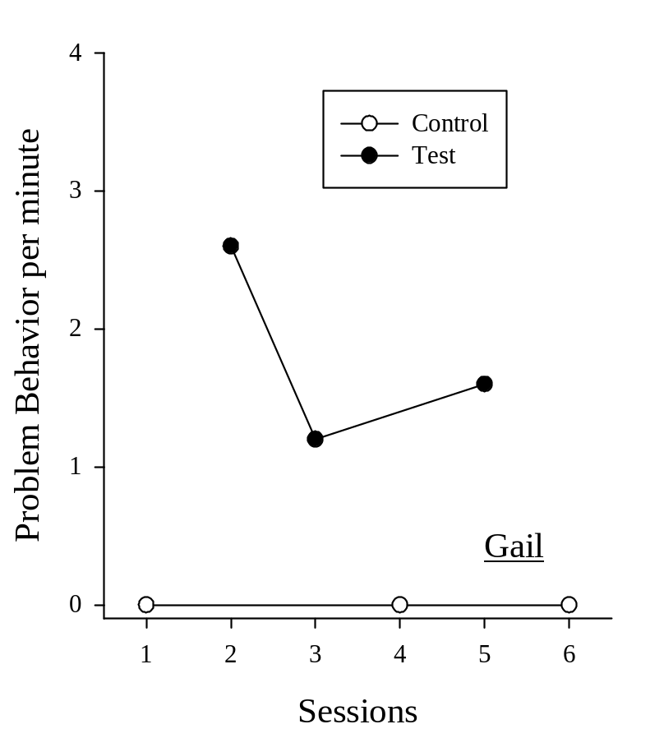
Case Example: Gail, 3 years old, PDD-NOS
Test: Mom attends to other tasks and people….
As soon as Gail engaged in any problem behavior, Mom directs her undivided attention to Gail while interacting with her and her most preferred toys.
In the test, we are emulating the conditions Mom described as being associated with Gail’s problem behavior.
Notes:
I will describe the assessment for Gail, the 3 year old girl first. Gail had long beautiful dark hair, her mother always dressed her impeccably, and Gail was quite excellent with dramatic play. The main issue was that she had 5 to 10 meltdowns per day that lasted from a few minutes to about an hour and it was difficult for her mother to ever predict which one was coming. She also was very aggressive towards siblings and parents, and highly noncompliant with adult instructions.
The interview suggested that Gail engaged in meltdowns and aggression in order to obtain preferred items (usually toys) and maternal attention. This is where I like to point out that extraordinary behavior is usually influenced by very ordinary events and interactions.
Our analysis then involves two conditions—the test, in which we try to emulate the conditions under which the problem has been reported to occur and the control, in which the factors thought to be responsible for problem behavior are removed. We alternate between 5 min test and control sessions in small observations rooms in our outpatient clinic at the university.

Slide 28
Functional Analysis
Systematic observation within two different and carefully designed contexts
  2) a period of time in which the variables thought to be responsible for problem behavior are removed
    -the presumed reinforcers are provided the entire time
  This is called the Control condition
Notes:
A functional assessment is a process; a process in which the variables influencing problem behavior are identified prior to treatment and are used to inform the treatment development.
The process usually involves some sort of combination of indirect assessment, descriptive assessment, and functional analysis. Descriptive assessment involves observation and measurement of the problem behavior and its context; by contrast, functional analysis consists of observation and measurement of the problem behavior in at least two contexts, each distinctly designed from the interview so that the variables suspected of influencing problem behavior are conspicuously present in one (referred to as the test condition) and absent in the other (referred to as the control condition).
*Functional analyses of problem behavior are prominent in the behavioral assessment literature having appeared in over 400 studies through last year with almost a 1000 distinct analyses published.
In his review large review of treatments for problem behaviors associated with autism, Campbell found that larger reductions in problem behavior were clearly evident when a functional analysis was part of the functional assessment process.

Slide 29
Case Example: Gail, 3 years old, PDD-NOS
Control: Mom directs her undivided attention to Gail while interacting with her and her most preferred toys the entire time.
In the control, we are emulating the conditions Mom described as being associated with no problem behavior.
Notes:
I will describe the assessment for Gail, the 3 year old girl first. Gail had long beautiful dark hair, her mother always dressed her impeccably, and Gail was quite excellent with dramatic play. The main issue was that she had 5 to 10 meltdowns per day that lasted from a few minutes to about an hour and it was difficult for her mother to ever predict which one was coming. She also was very aggressive towards siblings and parents, and highly noncompliant with adult instructions.
The interview suggested that Gail engaged in meltdowns and aggression in order to obtain preferred items (usually toys) and maternal attention. This is where I like to point out that extraordinary behavior is usually influenced by very ordinary events and interactions.
Our analysis then involves two conditions—the test, in which we try to emulate the conditions under which the problem has been reported to occur and the control, in which the factors thought to be responsible for problem behavior are removed. We alternate between 5 min test and control sessions in small observations rooms in our outpatient clinic at the university.

Slide 30
Case Example: Gail, 3 years old, PDD-NOS
By alternating between 5 minute periods of test and control conditions, we were able to turn on and off Gail’s problem behavior….
Giving us and her Mom confidence as to why she was engaging in the extraordinary problem behavior
….to simply gain and maintain her Mom’s undivided attention and play time
Notes:
I will describe the assessment for Gail, the 3 year old girl first. Gail had long beautiful dark hair, her mother always dressed her impeccably, and Gail was quite excellent with dramatic play. The main issue was that she had 5 to 10 meltdowns per day that lasted from a few minutes to about an hour and it was difficult for her mother to ever predict which one was coming. She also was very aggressive towards siblings and parents, and highly noncompliant with adult instructions.
The interview suggested that Gail engaged in meltdowns and aggression in order to obtain preferred items (usually toys) and maternal attention. This is where I like to point out that extraordinary behavior is usually influenced by very ordinary events and interactions.
Our analysis then involves two conditions—the test, in which we try to emulate the conditions under which the problem has been reported to occur and the control, in which the factors thought to be responsible for problem behavior are removed. We alternate between 5 min test and control sessions in small observations rooms in our outpatient clinic at the university.

Slide 31
If the problem behavior occurs with regularity,
it is being reinforced
Notes:
(there is some improvement in the environment for the child following problem behavior)
and the only way to identify the reinforcer is by conducting a functional assessment.

Slide 32
Our functional assessment process is unique because it is very
Effective
Fast
Safe
Useful
Notes:
Our functional assessment process is unique because it is very
Effective
Fast
Safe
Useful Useful for teaching skills

Slide 33
Treatment should yield effective inclusion
Communication Toleration
    "Toleration . . . is the greatest gift
    of the mind" (Helen Keller).
“Communication is a skill that you
can learn. It's like riding a
bicycle or typing. If you're
willing to work at it,
you can rapidly improve the quality
of every part of your life”
(Brian Tracy).
Notes:
“Communication is a skill that you can learn. It's like riding a bicycle or typing. If you're willing to work at it, you can rapidly improve the quality of every part of your life” (Brian Tracy).
"Toleration . . . is the greatest gift of the mind" (Helen Keller).
To be a good citizen and to be included in contexts that will promote growth there needs to be a balance between communication and toleration

Slide 34
Once we identify the reinforcing contingency for the problem behavior, we
    Teach the child how to effectively communicate for their reinforcers
    Teach the child how to tolerate times when the reinforcer is unavailable
    Extend this skill based treatment to relevant people and contexts
Notes:
Let me sum up the implications:
If problem behavior occurs with regularity in a child with autism, it is being reinforced. It is a simple but powerful assumption because it leads to quick assessment and personalized treatment of the problem.
Solution involves four main steps:
Identify the reinforcers
Teach them better ways to get those reinforcers
Teach them to handle when they can’t have those reinforcers
Train others how to continue with these teachings

Slide 35
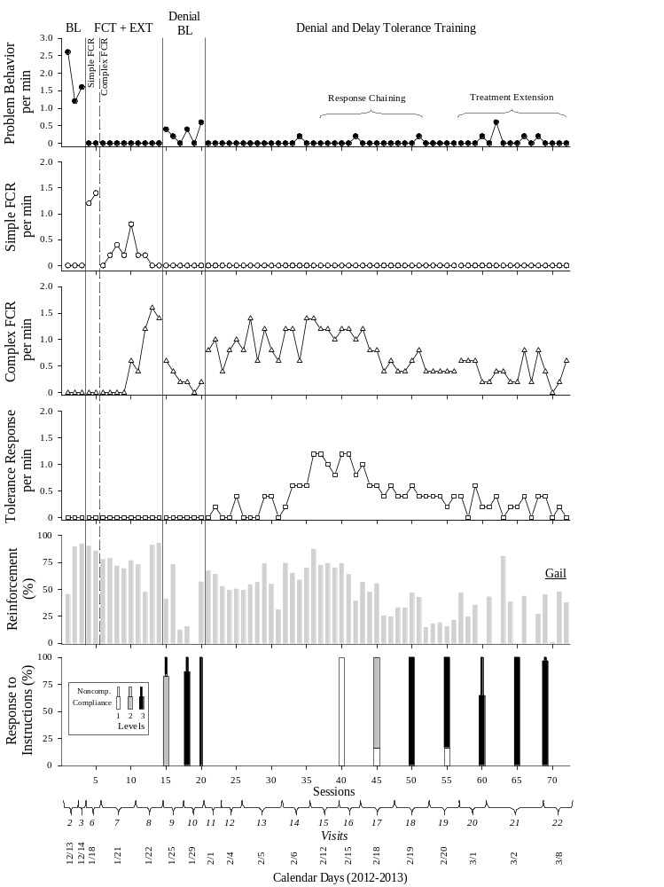
Meltdowns and aggression
“Play with me”
“Excuse me,” waits for acknowledgement from parent, then says, “Will you play with me, please” with appropriate tone and volume
Saying, “okay” while glancing at parent who just said “No,” Wait,” “Hold on,” or “in a minute”
Notes:
This bridge study involved 3 children…the first three served by our severe problem behavior clinic two years ago. They ranged in age from 3 to 11, were all on the autism spectrum, and all engaged in severe problem behavior in the form of meltdowns, aggression towards parents and siblings, screaming, and property destruction.

Slide 36
Reinforcement: Time with Mom’s undivided attention and preferred toys
Compliance: Doing whatever Mom asked her to do quickly and completely
Notes:
This bridge study involved 3 children…the first three served by our severe problem behavior clinic two years ago. They ranged in age from 3 to 11, were all on the autism spectrum, and all engaged in severe problem behavior in the form of meltdowns, aggression towards parents and siblings, screaming, and property destruction.

Slide 37
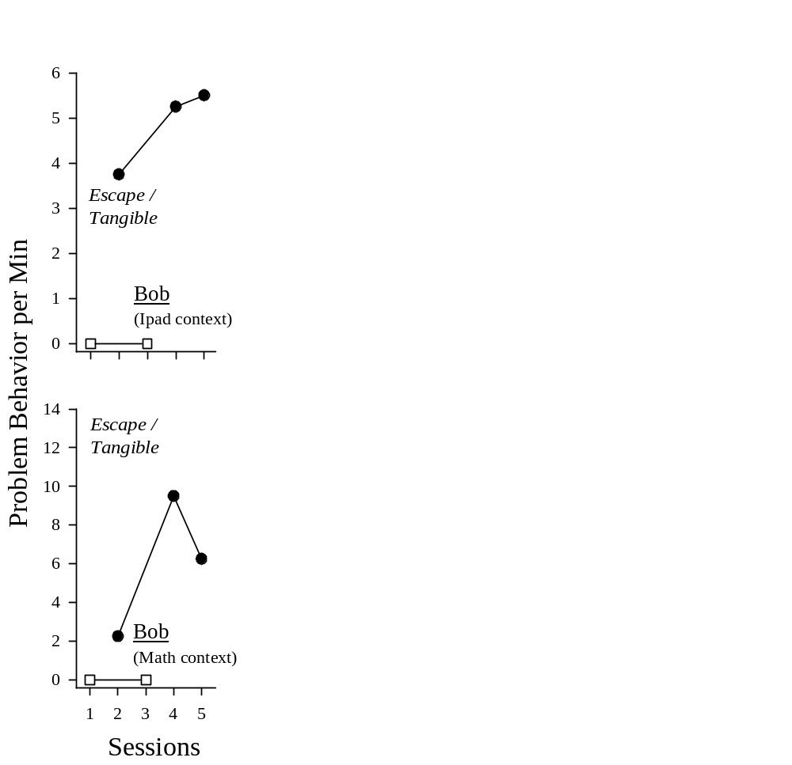
Case Example (Bob, 8 yo, dx: Autism)
Hypothesis:
Bob engages in meltdowns and aggression in order to obtain:
“His way” in the form of escape from adult instructions and access to preferred ways of interacting with electronics or academic materials
Notes:
This case example involves an 8 yo boy diagnosed with autism. He was fair skinned, red headed, hefty, uniquely gifted in math, had a great smile and very loving parents. School administrators were at their wits end attempting to educate Bob and his parents rarely left the house with him other than to take him to school because of his meltdowns.
The 50-min interview showed that problem behaviors (yelling, hitting, throwing or destroying property) occurred whenever Bob did not get his way. Problems occurred especially when someone played the “wrong” apps or “wrong” way on an ipad or when someone did math incorrectly or corrected his way of doing math.
Our analyses showed this to indeed be the case. For instance, in the math context control condition, Bob was allowed to complete his math worksheets in any way he wanted, uninterrupted and never corrected. By contrast, prompts to do a particular math problem a particular way were provided and if he had problem behavior he was allowed to do it his way for 30 s in the test condition. We only saw problem behavior in these test sessions.

Slide 38
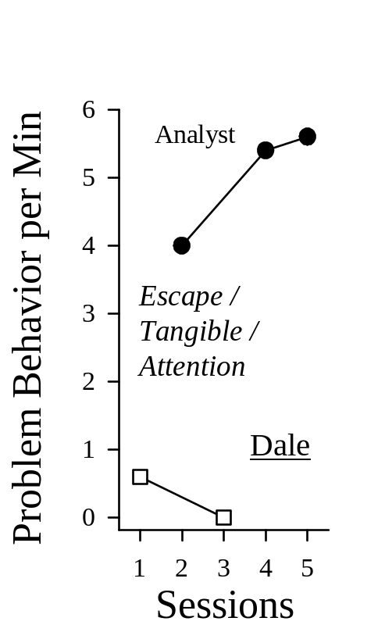
Case Example (Dale, 11 yo, dx: Autism)
Hypothesis:
Dale engages in meltdowns and aggression in order to obtain:
“His way” in the form of escape from adult instructions and access to preferred (tangible) items, and adult attention.
Notes:
Dale was an 11 yo boy with autism who was essentially running the show at home. He was very demanding and when his requests were not honored, he would scream or become aggressive or destructive. In our test condition, we prompted Dale to complete homework and any problem behavior resulted in our terminating the prompts allowing him to walk away and watch a movie and we honored any of his requests during this “break” from homework. During the control condition he had access to his way the whole time (a permanent break with access to preferred items, adult interaction). You can see that we were able to turn his problem behavior on and off in the analysis confirming the hunch about the function of his problem behavior from the interviews.

Slide 39
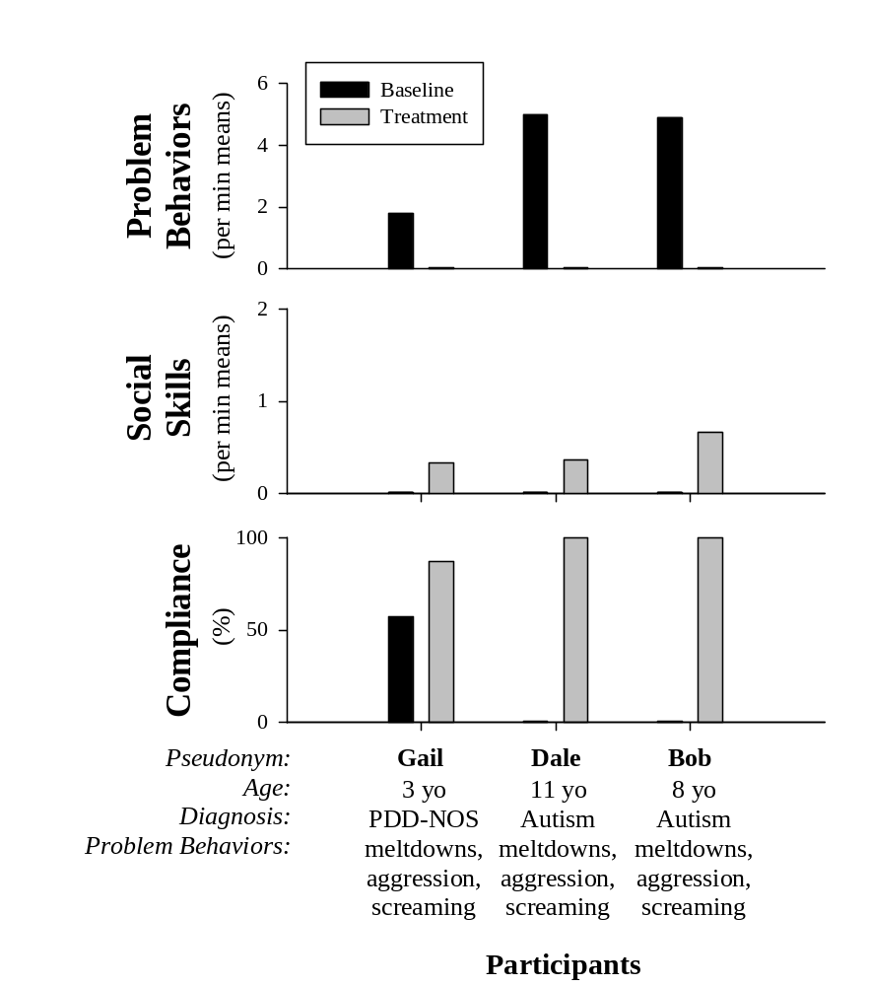
Outcomes (aggregated)
Notes:
Before we get into the procedural minutia, here are the outcomes for these children. High levels of problem behavior were directly observed in our baseline in the clinic (evident by the black bars). At the close of the assessment and treatment process, there were zero levels of problem behavior observed at the clinic and in the home, and social skills and compliance with adult instructions, that did not exist in baseline, were occurring at appropriate levels upon exit.
Talk about Bob doing other academic subjects and putting away his ipad
And dale doing his homework, chores and cleaning himself up.

Slide 40
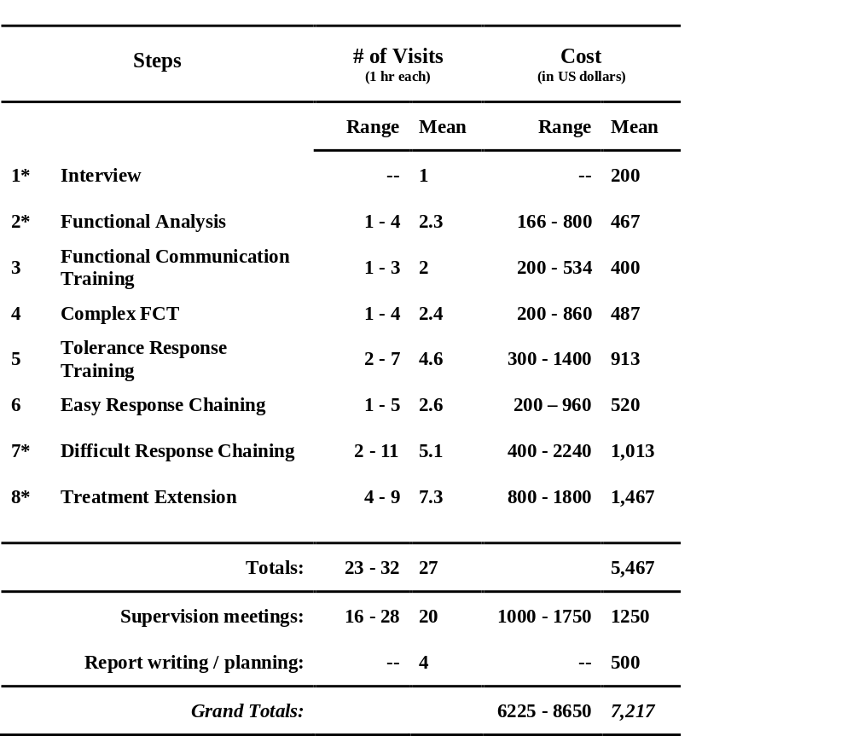
Cost Assessment
Notes:
Taking into account the going rates of the behavior analysts working together during this process, the projected cost for these outcomes is between 6 and 9000 us dollars.
Considering the much higher costs of inpatient psychological services (which is about $8000 per day), out-of-district educational placements (which cost between 80 and 130,000 per year), or long-term supported care for individuals with autism, which was estimated to be 3.2 million dollars across their lifetime, proper assessment and treatment of these problem behaviors while children with autism are young seems a reasonable investment.
This process costs about the same as a family of 4 week long vacation in Disneyworld, about the same as smoking 2 packs a day in Massachusetts, or about the same as getting the navigation, moon roof package, and wood paneling package in an SUV.

Slide 41
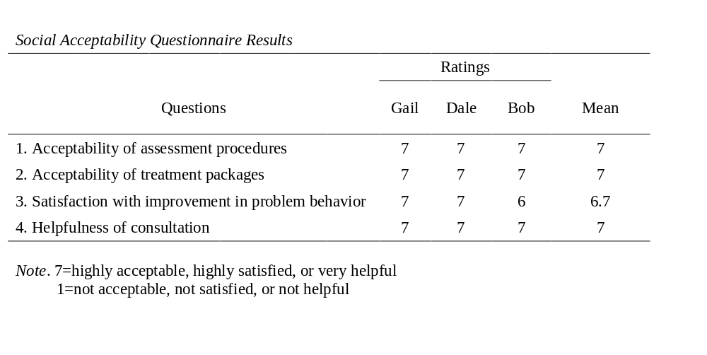
General Social Validity Data
Notes:
The same treatment process was replicated with Gail and Bob. At the conclusion of treatment, families returned to the outpatient clinic to complete a social validity questionnaire and to ask any questions about treatment implementation. All parents reported that they found the assessment procedures and treatment packages highly acceptable, the improvement in problem behavior highly acceptable, and overall consultation very helpful.
It not only works well and leads to general outcomes but people like the process and outcomes and it is these data that my research and practice group is most proud of.

Slide 42
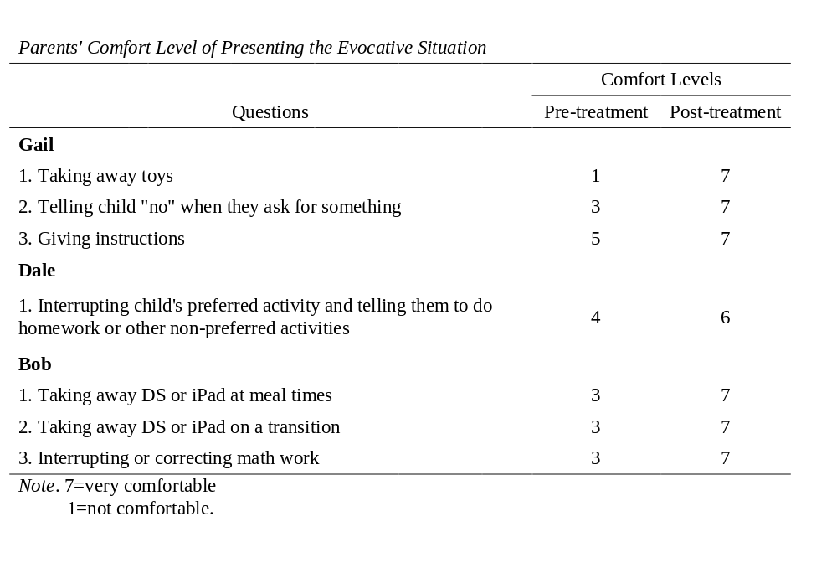
Personalized Social validity Data
Notes:
When asked about their comfort level with presenting the specific situations that were initially reported to evoke problem behavior, ratings improved for all parents between the initial and their last meeting with the behavior analyst and the parents reported being very comfortable with presenting evocative situations after being trained on the treatment.

Slide 43
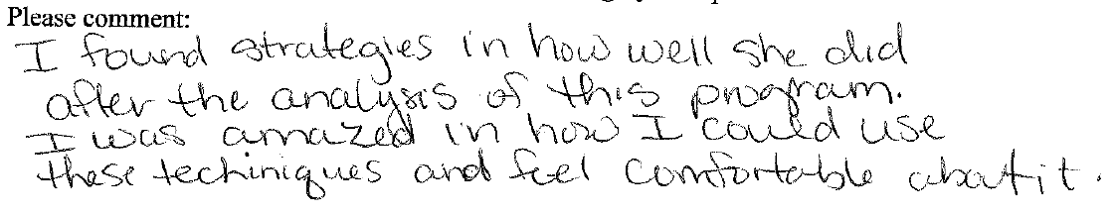
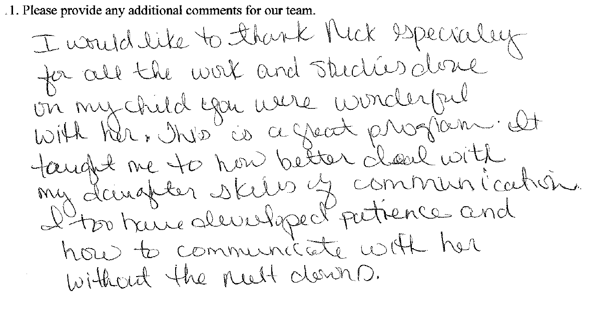
Some open-ended responses from the Social Acceptability Questionnaire

Slide 44
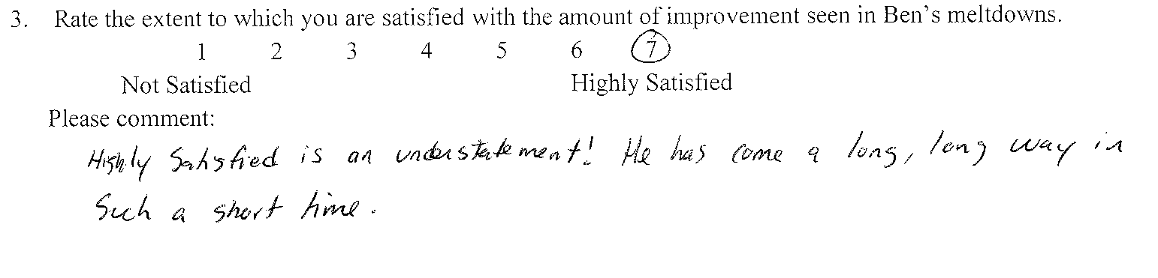
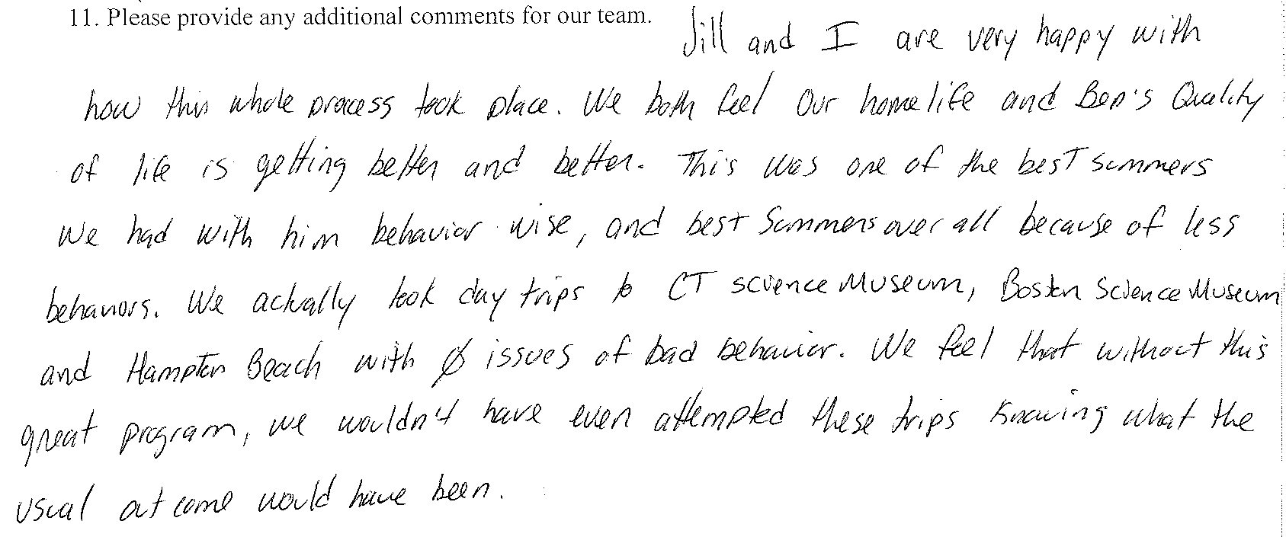
Notes:
These are two of the more legible responses to open-ended questions.

Slide 45
Implications
If the problem behavior occurs with regularity,
it is being reinforced
Notes:
Let me sum up the implications:
If problem behavior occurs with regularity in a child with autism, it is being reinforced. It is a simple but powerful assumption because it leads to quick assessment and personalized treatment of the problem.
Solution involves four main steps:
Identify the reinforcers
Teach them better ways to get those reinforcers
Teach them to handle when they can’t have those reinforcers
Train others how to continue with these teachings

Slide 46
  Solution involves four main steps:
    Identify the reinforcers
    Strengthen alternative behavior with the reinforcers
    Teach child to tolerate reinforcers being unavailable
    Have relevant people manage the reinforcers in real contexts
Notes:
Let me sum up the implications:
If problem behavior occurs with regularity in a child with autism, it is being reinforced. It is a simple but powerful assumption because it leads to quick assessment and personalized treatment of the problem.
Solution involves four main steps:
Identify the reinforcers
Teach them better ways to get those reinforcers
Teach them to handle when they can’t have those reinforcers
Train others how to continue with these teachings

Slide 47
Our treatments result in generalized and socially validated improvements in problem behavior because they are
Skill-based
Progressive
Address communication and toleration
Continuously informed by parent’s goals
based on a scientifically valid means for identifying the reinforcer
Notes:
Useful for teaching skills

Slide 48
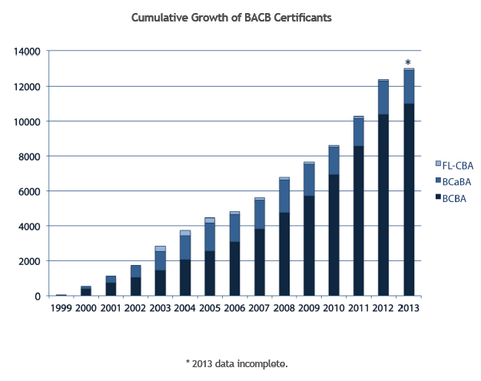
Implications
Solution is simple to describe but more complex in execution
  Specific skills
  of a BCBA are
  required
  We need more
  and better
  training
  programs,
  hospitals,
  and schools
  that embrace
  behavior
  analysis
Notes:
The solution is simple to describe but more complex in execution
The specific skills of a board certified behavior analyst are often needed. The good news is that the number of certified behavior analysts is growing at a fast rate. The bad news is that there are still way too few behavior analysts in places where parents go for help with their son or daughter who is engaging in severe problem behavior.
It follows then that we need more and better training programs and we need hospitals that embrace behavior analysis.

Slide 49
Implications
Medication is not the solution
for meltdowns, aggression, or disruptive behavior exhibited by children with autism
Notes:
It should not come as a surprise that all of these children were being medicated to address their problem behavior (risperidol, clonidine, nuerontin, tegretol, & adderal). The parents and their physicians agreed to safely eliminate the medications prior to starting the assessment process in our clinic.
These experiences, plus many others, in addition to careful reviews of the pharmacological literature for problem behavior associated with autism reveals that:
Medication is not the solution for meltdowns, aggression, or the self-injury exhibited by children with autism
There is no good evidence for medication decreasing problem behavior while strengthening socially desirable alternatives
When there are demonstrated positive effects, they are merely statistically significant changes in reported levels of problem behavior of unknown social significance
and those effects probably represent lethargy or enhanced placebo effects; we await properly controlled studies and comparative analyses.
Our own analysis is limited at this point by lack of long term follow up data and an absence of demonstrated effects on more global measures of functioning. We hope to incorporate these measurement additions in future efforts as we scale up this research to practice line of inquiry.

Slide 50
Implications
  There is no good evidence for medication decreasing these problem behaviors
  while
  strengthening socially desirable alternatives
Notes:
It should not come as a surprise that all of these children were being medicated to address their problem behavior (risperidol, clonidine, nuerontin, tegretol, & adderal). The parents and their physicians agreed to safely eliminate the medications prior to starting the assessment process in our clinic.
These experiences, plus many others, in addition to careful reviews of the pharmacological literature for problem behavior associated with autism reveals that:
Medication is not the solution for meltdowns, aggression, or the self-injury exhibited by children with autism
There is no good evidence for medication decreasing problem behavior while strengthening socially desirable alternatives
When there are demonstrated positive effects, they are merely statistically significant changes in reported levels of problem behavior of unknown social significance
and those effects probably represent lethargy or enhanced placebo effects; we await properly controlled studies and comparative analyses.
Our own analysis is limited at this point by lack of long term follow up data and an absence of demonstrated effects on more global measures of functioning. We hope to incorporate these measurement additions in future efforts as we scale up this research to practice line of inquiry.

Slide 51
Implications
    When there are demonstrated positive effects, they are merely statistically significant changes in reported levels of problem behavior,
    with the change of unknown social significance
      and those effects probably represent lethargy or enhanced placebo effects
Notes:
It should not come as a surprise that all of these children were being medicated to address their problem behavior (risperidol, clonidine, nuerontin, tegretol, & adderal). The parents and their physicians agreed to safely eliminate the medications prior to starting the assessment process in our clinic.
These experiences, plus many others, in addition to careful reviews of the pharmacological literature for problem behavior associated with autism reveals that:
Medication is not the solution for meltdowns, aggression, or the self-injury exhibited by children with autism
There is no good evidence for medication decreasing problem behavior while strengthening socially desirable alternatives
When there are demonstrated positive effects, they are merely statistically significant changes in reported levels of problem behavior of unknown social significance
and those effects probably represent lethargy or enhanced placebo effects; we await properly controlled studies and comparative analyses.
Our own analysis is limited at this point by lack of long term follow up data and an absence of demonstrated effects on more global measures of functioning. We hope to incorporate these measurement additions in future efforts as we scale up this research to practice line of inquiry.

Slide 52
Limitations / Future Directions
We are currently working to obtain support for a follow up study which will include:
measurement of the effect of consultation throughout day and over an extensive period of time
Notes:
Greater recognition of and support for highly efficacious functional assessment and treatment processes is probably dependent on the inclusion of these additional measures within randomized controlled trials in future research.

Slide 53
Limitations / Future Directions
We are currently working to obtain support for a follow up study which will include
additional global measures of functioning
before and after the consultations
Notes:
Greater recognition of and support for highly efficacious functional assessment and treatment processes is probably dependent on the inclusion of these additional measures within randomized controlled trials in future research.

Slide 54
Limitations / Future Directions
We are currently working to obtain support for a follow up study which will include
additional participants randomly assigned
to either receive consultation
or traditional care
  with the latter group eventually receiving treatment
Notes:
Greater recognition of and support for highly efficacious functional assessment and treatment processes is probably dependent on the inclusion of these additional measures within randomized controlled trials in future research.

Slide 55
Please share this Take-Home Point
Autism is not a life sentence of:
Meltdowns
Aggression
Self-injury
Notes:
And last, as practitioners, we are not done treating automatically-reinforced stereotypy until it goes away when that someone is alone. When it goes away in the baseline from which we found the behavior.
This is a tall order, this is not something that can be completed in a few months. This is a long term commitment. But, I am confident it can be done…because we have seen it happen with children in good EIBI programs after a 2 to 3 years of solid intervention.
These long-term evaluations of stereotypy treatments are that which is now needed to determine if behavior-analytic technology is essential for treating these very common, intractable behaviors associated with autism.

Slide 56

Freedom from these problem behaviors is possible and probable with:
BCBA-led, objective analysis
Skill-based treatments yielding functional reinforcers
Skill-based delay tolerance procedures
Notes:
And last, as practitioners, we are not done treating automatically-reinforced stereotypy until it goes away when that someone is alone. When it goes away in the baseline from which we found the behavior.
This is a tall order, this is not something that can be completed in a few months. This is a long term commitment. But, I am confident it can be done…because we have seen it happen with children in good EIBI programs after a 2 to 3 years of solid intervention.
These long-term evaluations of stereotypy treatments are that which is now needed to determine if behavior-analytic technology is essential for treating these very common, intractable behaviors associated with autism.

Slide 57
Persons diagnosed with Autism
often engage in repetitive acts
that appear to serve no function
Notes:
As noted earlier, autism ….is characterized by impairments in language, social interaction, and by patterns of repetitive behavior. These patterns of repetitive behavior appear purposeless, serving no important purpose for the person with autism

Slide 58
These acts are collectively referred to as
stereotypy
due to the formal similarity of the acts
and the periodicity with which they are emitted
Notes:
These patterns of repetitive behavior that appear purposeless are often referred to as stereotypy due to the formal similarity of the acts and the periodicity with which they are emitted.
Stereotypy takes many forms— the acts may be vocal or they may involve non-vocal motor movements with or without objects. Today, I will mainly focus on stereotypical motor movements.

Slide 59
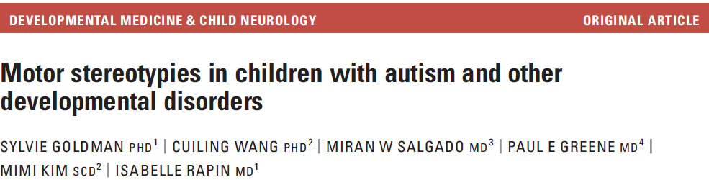
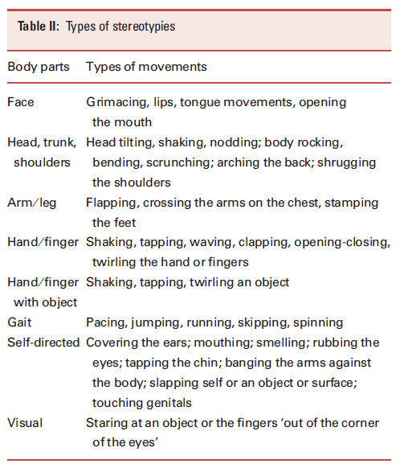
Notes:
An article by Goldman and colleagues provides a nice description of the topographical range that is observed with motor stereotypies in persons diagnosed with autism. Here is a list of typical forms categorized by body parts.
During standardized play sessions, these authors observed about 130 children with autism and about 150 cognitively matched children who were developmentally delayed but not autistic, and they used an open-ended observation protocol to describe the amount and type of motor stereotypies in each group.

Slide 60
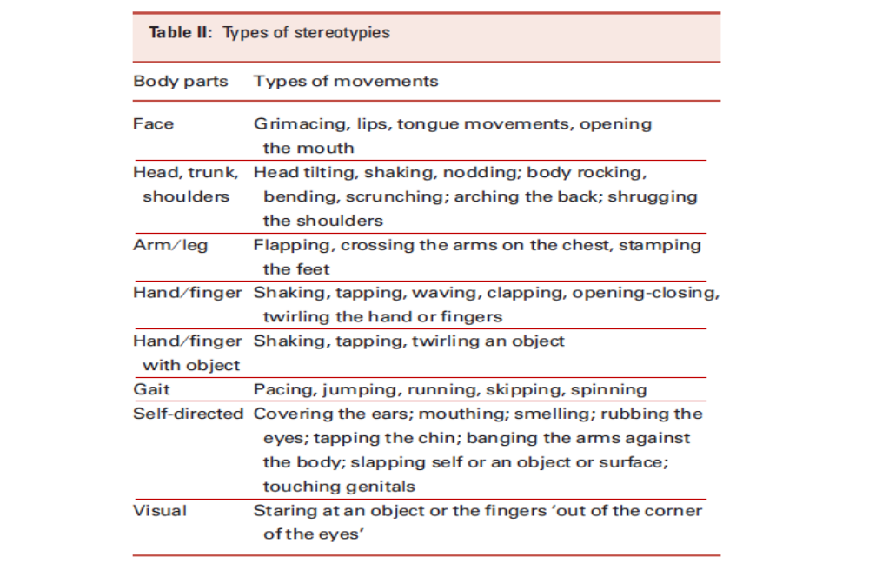
Notes:
A recent article by Goldman and colleagues provides a nice description of the topographical range that is observed with motor stereotypies in persons diagnosed with autism. Here is a list of typical forms categorized by body parts.
During standardized play sessions, these authors observed about 130 children with autism and about 150 cognitively matched children who were developmentally delayed but not autistic, and they used an open-ended observation protocol to describe the amount and type of motor stereotypies in each group.

Slide 61
Stereotypy is usually maintained by sensory (automatic) reinforcement)
Notes:
It appears that behavior analysts are called in to address stereotypy when it is exhibited with impairing frequency. But it is not the number or amount per se. There is no magic number—600 hand flaps per day is okay but 1000 hand flaps requires our attention. It is not like that.
I know it goes against the frequently favored strength-based framing of autism, but for me autism is characterized by deficits in language and social interaction and other important socially-constructed skills like number and letter identification. That which many children of typical development learn by accident or through largely unstructured and unplanned interactions requires careful and systematic teaching for children with autism to learn. *** Stereotypy is a problem when it interferes with these important systematic teaching periods.
Stereotypy is also a problem when it routinely interferes with common social interactions. Todd Risley often described social interactions as a dance, two people participating in a graceful series of interactions and exchanges. When kids are constantly performing solos (in today’s parlance, they are crunking, and popping) when the conditions call for a waltz, stereotypy is a problem.
***The troublesome nature of stereotypy is sometimes amplified when caregivers attempt to prohibit the behavior during teaching periods or social conditions and that interaction evokes more serious problem behavior like aggression or self-injury. Stereotypy, regardless of any particular frequency, is a problem under these conditions and one that demands our attention.
So we know what stereotypy is and when it is a problem, but we are not ready to develop a treatment yet because despite the assumption that all stereotypy is self stimulatory or produces its own reinforcement, we should be careful to recognize that all forms of behavior are functionally fickle.

Slide 62
When is Stereotypy a Problem?
….when it is exhibited with impairing frequency
Notes:
It appears that behavior analysts are called in to address stereotypy when it is exhibited with impairing frequency. But it is not the number or amount per se. There is no magic number—600 hand flaps per day is okay but 1000 hand flaps requires our attention. It is not like that.
I know it goes against the frequently favored strength-based framing of autism, but for me autism is characterized by deficits in language and social interaction and other important socially-constructed skills like number and letter identification. That which many children of typical development learn by accident or through largely unstructured and unplanned interactions requires careful and systematic teaching for children with autism to learn. *** Stereotypy is a problem when it interferes with these important systematic teaching periods.
Stereotypy is also a problem when it routinely interferes with common social interactions. Todd Risley often described social interactions as a dance, two people participating in a graceful series of interactions and exchanges. When kids are constantly performing solos (in today’s parlance, they are crunking, and popping) when the conditions call for a waltz, stereotypy is a problem.
***The troublesome nature of stereotypy is sometimes amplified when caregivers attempt to prohibit the behavior during teaching periods or social conditions and that interaction evokes more serious problem behavior like aggression or self-injury. Stereotypy, regardless of any particular frequency, is a problem under these conditions and one that demands our attention.
So we know what stereotypy is and when it is a problem, but we are not ready to develop a treatment yet because despite the assumption that all stereotypy is self stimulatory or produces its own reinforcement, we should be careful to recognize that all forms of behavior are functionally fickle.

Slide 63
When is Stereotypy a Problem?
….when it is exhibited with impairing frequency
  when it interferes with attempts
  to teach skills or concepts
Notes:
It appears that behavior analysts are called in to address stereotypy when it is exhibited with impairing frequency. But it is not the number or amount per se. There is no magic number—600 hand flaps per day is okay but 1000 hand flaps requires our attention. It is not like that.
I know it goes against the frequently favored strength-based framing of autism, but for me autism is characterized by deficits in language and social interaction and other important socially-constructed skills like number and letter identification. That which many children of typical development learn by accident or through largely unstructured and unplanned interactions requires careful and systematic teaching for children with autism to learn. *** Stereotypy is a problem when it interferes with these important systematic teaching periods.
Stereotypy is also a problem when it routinely interferes with common social interactions. Todd Risley often described social interactions as a dance, two people participating in a graceful series of interactions and exchanges. When kids are constantly performing solos (in today’s parlance, they are crunking, and popping) when the conditions call for a waltz, stereotypy is a problem.
***The troublesome nature of stereotypy is sometimes amplified when caregivers attempt to prohibit the behavior during teaching periods or social conditions and that interaction evokes more serious problem behavior like aggression or self-injury. Stereotypy, regardless of any particular frequency, is a problem under these conditions and one that demands our attention.
So we know what stereotypy is and when it is a problem, but we are not ready to develop a treatment yet because despite the assumption that all stereotypy is self stimulatory or produces its own reinforcement, we should be careful to recognize that all forms of behavior are functionally fickle.

Slide 64
When is Stereotypy a Problem?
….when it is exhibited with impairing frequency
  when it interferes with social interactions
Notes:
It appears that behavior analysts are called in to address stereotypy when it is exhibited with impairing frequency. But it is not the number or amount per se. There is no magic number—600 hand flaps per day is okay but 1000 hand flaps requires our attention. It is not like that.
I know it goes against the frequently favored strength-based framing of autism, but for me autism is characterized by deficits in language and social interaction and other important socially-constructed skills like number and letter identification. That which many children of typical development learn by accident or through largely unstructured and unplanned interactions requires careful and systematic teaching for children with autism to learn. *** Stereotypy is a problem when it interferes with these important systematic teaching periods.
Stereotypy is also a problem when it routinely interferes with common social interactions. Todd Risley often described social interactions as a dance, two people participating in a graceful series of interactions and exchanges. When kids are constantly performing solos (in today’s parlance, they are crunking, and popping) when the conditions call for a waltz, stereotypy is a problem.
***The troublesome nature of stereotypy is sometimes amplified when caregivers attempt to prohibit the behavior during teaching periods or social conditions and that interaction evokes more serious problem behavior like aggression or self-injury. Stereotypy, regardless of any particular frequency, is a problem under these conditions and one that demands our attention.
So we know what stereotypy is and when it is a problem, but we are not ready to develop a treatment yet because despite the assumption that all stereotypy is self stimulatory or produces its own reinforcement, we should be careful to recognize that all forms of behavior are functionally fickle.

Slide 65
When is Stereotypy a Problem?
….when it is exhibited with impairing frequency
  when the prohibition of stereotypy results in more serious problem behavior
    (DeLeon et al., 2011)
Notes:
It appears that behavior analysts are called in to address stereotypy when it is exhibited with impairing frequency. But it is not the number or amount per se. There is no magic number—600 hand flaps per day is okay but 1000 hand flaps requires our attention. It is not like that.
I know it goes against the frequently favored strength-based framing of autism, but for me autism is characterized by deficits in language and social interaction and other important socially-constructed skills like number and letter identification. That which many children of typical development learn by accident or through largely unstructured and unplanned interactions requires careful and systematic teaching for children with autism to learn. *** Stereotypy is a problem when it interferes with these important systematic teaching periods.
Stereotypy is also a problem when it routinely interferes with common social interactions. Todd Risley often described social interactions as a dance, two people participating in a graceful series of interactions and exchanges. When kids are constantly performing solos (in today’s parlance, they are crunking, and popping) when the conditions call for a waltz, stereotypy is a problem.
***The troublesome nature of stereotypy is sometimes amplified when caregivers attempt to prohibit the behavior during teaching periods or social conditions and that interaction evokes more serious problem behavior like aggression or self-injury. Stereotypy, regardless of any particular frequency, is a problem under these conditions and one that demands our attention.
So we know what stereotypy is and when it is a problem, but we are not ready to develop a treatment yet because despite the assumption that all stereotypy is self stimulatory or produces its own reinforcement, we should be careful to recognize that all forms of behavior are functionally fickle.

Slide 66
Common treatments for stereotypy
Enriched environment (toys)
or
Prompted engagement (teaching)
or
Response blocking (punishment)
are usually insufficient
Notes:
Gentle teaching, positive reinforcement, functional communication, choice making, proactive intervention.

Slide 67
Because sufficient treatments for stereotypy include:
Enriched environment
and
Prompted engagement
and
Response blocking
                and
                Differential reinforcement
(and not just any reinforcement….)
Notes:
Gentle teaching, positive reinforcement, functional communication, choice making, proactive intervention.

Slide 68
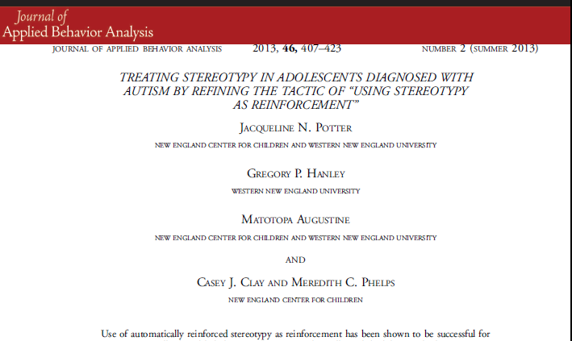
Notes:
The reinforcer we use is the stereotypy itself because ewe know that the act in and of itself is reinforcing.
Desirable change in stereotypy requires that changes be made to both the antecedents and consequences for stereotypy and for an alternative behavior and that more and better alternative behavior is painstakingly developed over time. Our most convincing applied literature is hyper-analytic in that the goals are to break treatments down to identify the functional components. This is good and necessary, but at the same time, it leaves us with a fractured technology distributed across different journal articles. While we are breaking down interventions, we also need to synthesize that which is known into effective treatment packages to make long term and meaningful differences in stereotypy.
We as a field have not yet achieved this goal.
Changing stereotypy is a developmental process; just like the one that unfold naturally with typically developing babies who almost all start out engaging exclusively in stereotypy and then learning how to derive reinforcement from other behavior-env interactions.

Slide 69
Three teenagers
  Jon
  Patrick
  Edward
Stereotypy
  hand flapping
  finger tapping or flicking
  body rocking
  mouthing
  eye pressing
  ear holding
Notes:
We are currently applying the model with 3 adolescents who have engaged in impairing rates of stereotypy for many years across all daily activities and settings. Each of these teenagers has a diagnosis of an autism spectrum disorder.
Their stereotypy took these forms (point).

Slide 70
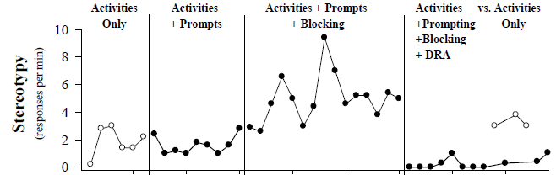
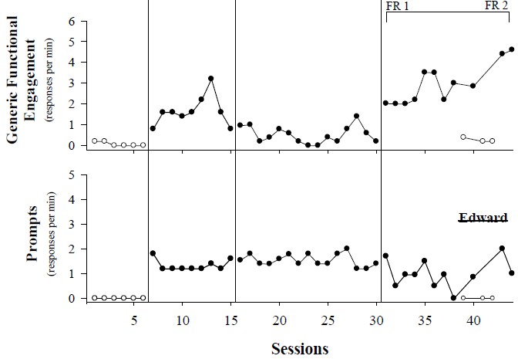
Edward
Notes:
We saw very similar effects with Edward—low levels of stereotypy and high levels of functional engagement were observed when and only when differential reinforcement was arranged.

Slide 71
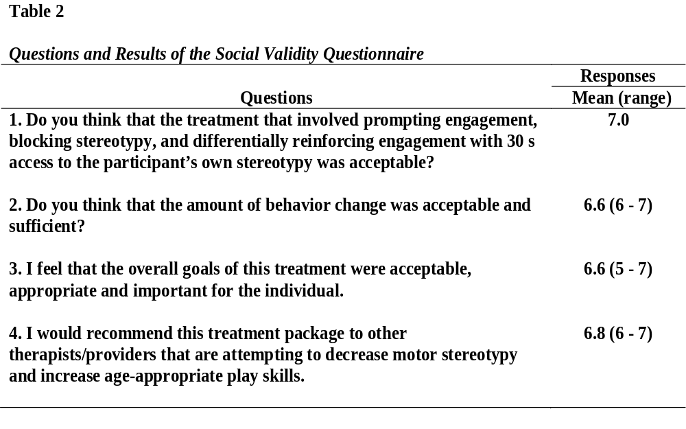
Notes:
Here are the specific questions and associated results. The scores were quite high, indicative of strong satisfaction with the goals, procedures, and outcomes. We are currently collecting these data for the other two boys.

Slide 72
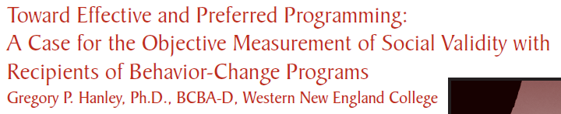


Similar inquiry, different respondent:
Which treatment did each teenager prefer?
Notes:
As we are prone to do in my research group, we also asked the boys which treatment they preferred. Unfortunately, this question requires a slightly more complex set of methods than that used with the other stakeholders. We refer to these methods as concurrent chains arrangements.
If you are interested in learning more about this procedure, please see this article published last year in Behavior Analysis in Practice.

Slide 73
Initial Links
Terminal Links
Contingency:
FR-1
Blocking Only
Pink Card
Activities Only
Light Blue Card
Royal Blue Card
Activities, Blocking, and
Contingent Access to Stereotypy
Notes:
For Jon, Pink was correlated with blocking only. When he selected this one, he sat at a table without activity materials and all attempts to engage in stereotypy were blocked. CLICK It looked like this.
Light blue was correlated with activities only. When he selected this one, he is sat at a Table with the activity materials and he was allowed to engage in stereotypy (there was no blocking). CLICK
Royal blue was correlated with the treatment package. With this one, activities were on the table. Stereotypy was blocked until he engaged the activities for a certain amount of time, then he was allowed to engage in stereotypy for about 30 s. CLICK
After experiencing each treatment for about 2 min, he was asked to leave the Tables and make another choice.

Slide 74
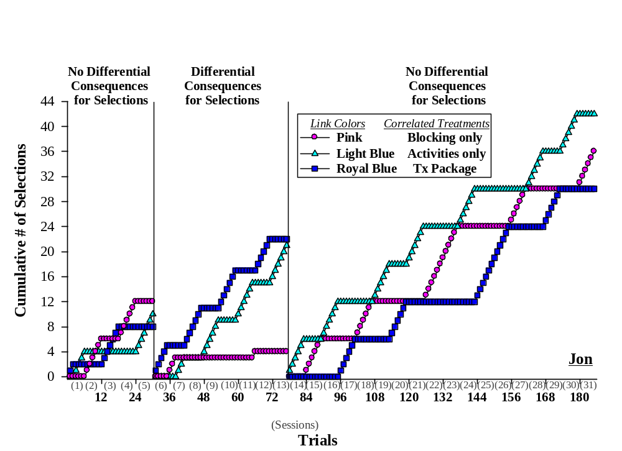
Notes:
We see a return to indiscriminate performance when we re-instated the non-differential consequences ….. suggesting that his selections were indeed under control of the treatments in this middle phase.

Slide 75
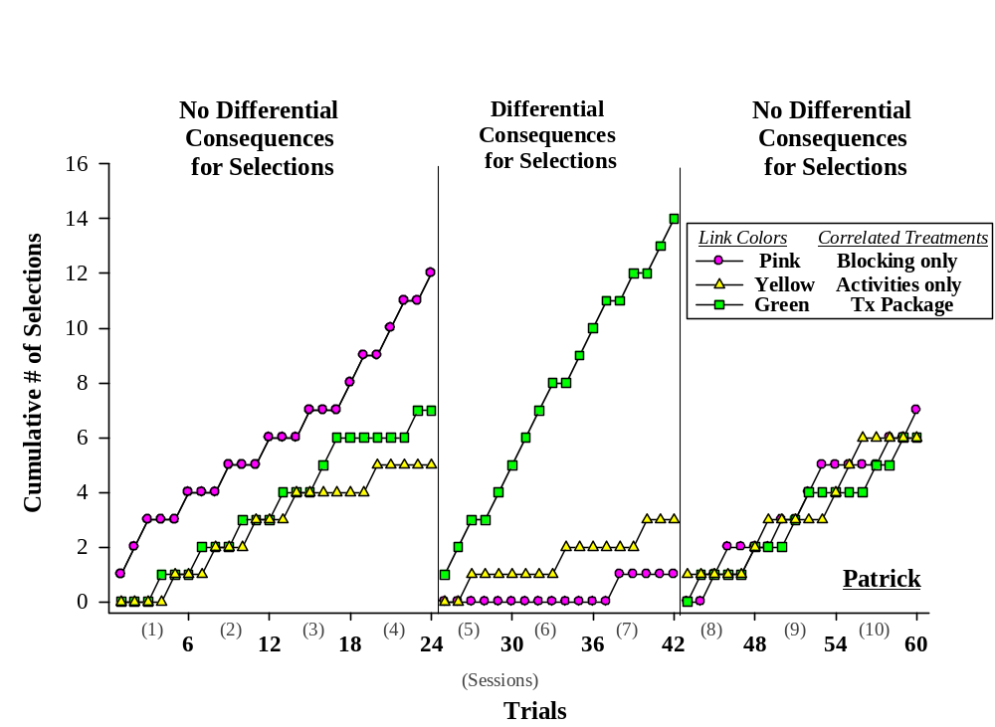
Notes:
When the colors were correlated with treatments, we see a strong preference for the Treatment package, and the final phase provides additional evidence that his selections were influenced by the treatments.
Let me emphasize here that Patrick could have accessed a condition in which he could play with the toys or engage in stereotypy at any time, but instead he routinely selected the condition in which his stereotypy was prevented until he emitted a requisite amount of engagement.

Slide 76
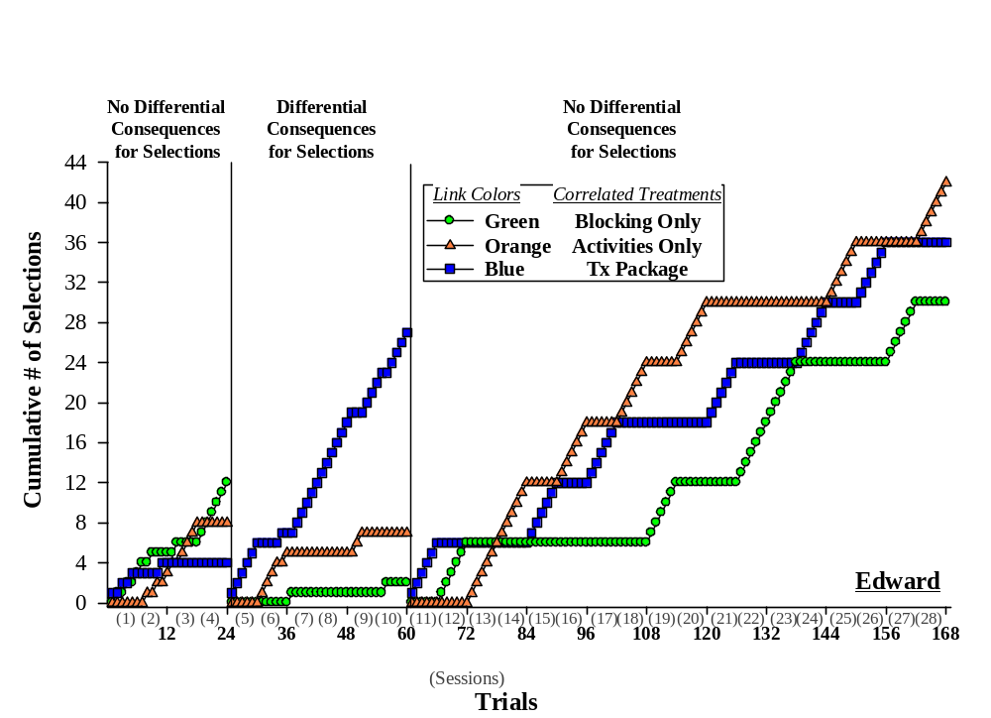
Notes:
And his discriminated selections abated once the differential treatment outcomes were removed.

Slide 77
Results Summary
No one preferred blocking only
No one avoided the treatment
with all three components
Two of three preferred the treatment
with all three components
Notes:
In sum: No one preferred blocking only. The efficacy data, which showed that blocking was ineffective, and these preference data, which showed that all boys avoided or at least did not prefer blocking only, should be considered every time we are inclined to write programs for motor stereotypy that consist of blocking only.
No one avoided the treatment with all three components, so any aversive aspects of blocking seem to be alleviated when there is a reinforcement component in the treatment,
and two of three boys preferred the treatment with all three components.

Slide 78
Why a preference for the treatment package?
Perhaps this is another example of people:
  avoiding extinction
  preferring contingent over noncontingent reinforcement
  preferring the treatment in which they were most effective
  (Hanley et al., 1997, Hanley, 2010; Luczynski & Hanley, 2009, 2010)
Notes:
Why a preference for the treatment package? I don’t know about you, but it is surprising to me that rather than have unfettered access to activities and stereotypy, these boys chose to participate in an arrangement in which their stereotypy was sometimes blocked and they earned only short bouts of stereotypy.
*** Is this another example of people avoiding extinction and preferring contingent reinforcement over noncontingent reinforcement….perhaps. I think so. Perhaps it is people’s strong preference for contingencies that is at play here.
Perhaps, like many other people who have been given the opportunity to choose their own behavioral interventions, these boys preferred the treatment in which they were most effective.

Slide 79
Some Take-Home Points
Don’t assume function
  Rule in or rule out different reinforcers for stereotypy via functional assessment
Notes:
In closing, I have some take home points regarding the treatment of motor stereotypies in persons with autism
First, please don’t assume behavioral function based on the form of behavior.
Instead, rule in or rule out maintenance of stereotypy via social reinforcers via proper functional analysis

Slide 80
Some Take-Home Points
It is important to recognize the necessity
and insufficiency of blocking
as a treatment for stereotypy
Notes:
Second, it is important to recognize the necessity and the insufficiency of blocking (or interrupting or redirecting) as a treatment for stereotypy
Differential reinforcement using stereotypy as the reinforcement is not possible without blocking. But blocking alone sets you up for integrity issues, bursts of stereotypy, and sometimes failure. Just like reinforcement effects depend on blocking, I would argue that blocking effects often also depend on some form of differential reinforcement.

Slide 81
Some Take-Home Points
Immediate treatment goal is not
elimination of stereotypy
More appropriate goal is having it occur in acceptable places and at acceptable times
Notes:
Third, the appropriate treatment goal for motor stereotypy is probably not elimination….the more appropriate goal is having it occur in an acceptable place and at an acceptable time.
By allowing stereotypy to occur sometime, you will be better equipped to eliminate it at other times—when it is very important to do so, like when you are teaching, like when you are facilitating social interaction, like when you would like the child to sleep at night….and so on…..

Slide 82
Some Take-Home Points
By allowing stereotypy
to occur sometime,
you will be better equipped
to manage it at other times
Notes:
Third, the appropriate treatment goal for motor stereotypy is probably not elimination….the more appropriate goal is having it occur in an acceptable place and at an acceptable time.
By allowing stereotypy to occur sometime, you will be better equipped to eliminate it at other times—when it is very important to do so, like when you are teaching, like when you are facilitating social interaction, like when you would like the child to sleep at night….and so on…..

Slide 83
Some Take-Home Points
Treatment success probably depends on
  using stereotypy as reinforcement
  to teach other ways to produce sensory reinforcement
  and
  teaching clients what to do when reinforcement is not available
Notes:
Not unlike that which I described for treating other problem behaviors….
So the main point remains the same….

Slide 84
Freedom from severe problem behavior and interfering stereotypy is possible and probable with:
BCBA-led, objective analysis
Skill-based treatments yielding functional reinforcers
Skill-based delay tolerance procedures
Notes:
Freedom from severe problem behavior and interfering stereotypy is possible and probable with:
BCBA-led, objective analysis
Skill-based treatments yielding functional reinforcers
Skill-based delay tolerance procedures

Slide 85
Thank you.
Good luck with all that you do for all who you teach and provide care
Contact info.:
Gregory P. Hanley, Ph.D., BCBA-D
Psychology Department
Western New England University
1215 Wilbraham Road
Springfield, Massachusetts 01119
ghanley@wne.edu
Notes:
Thank you for your time.

